Slide 1
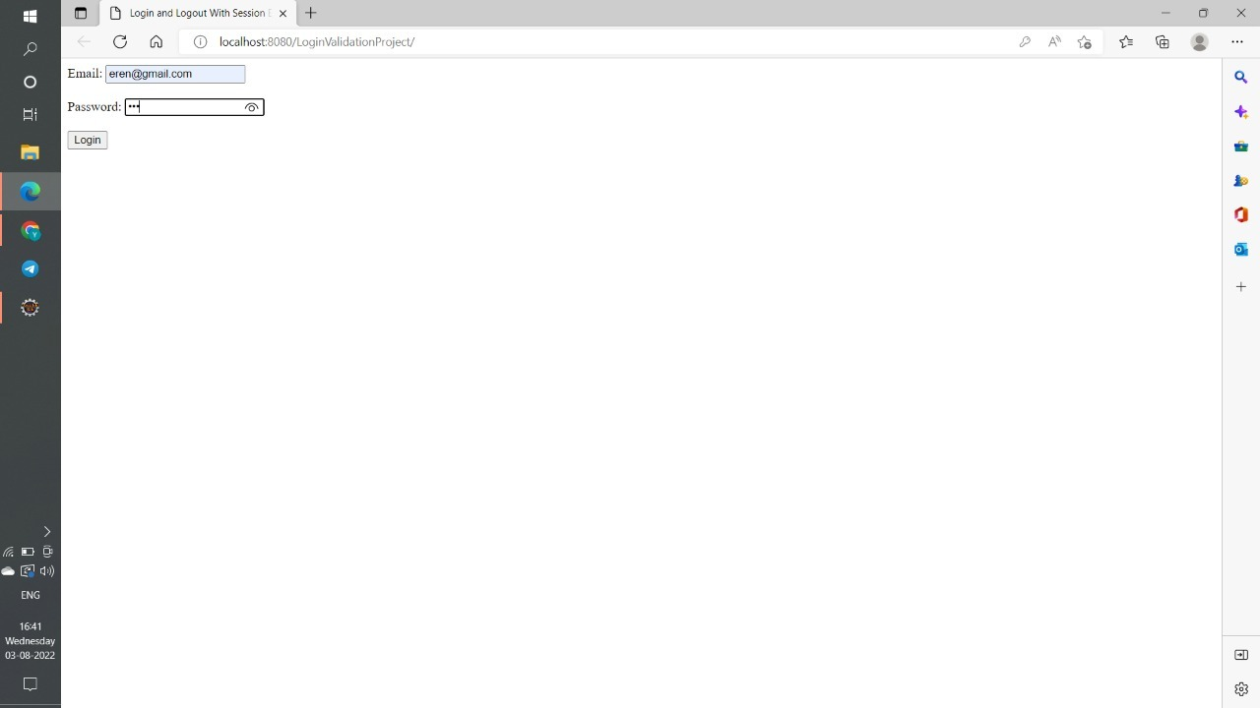
USER LOGIN VALIDATION OUTPUT SCREENSHOTS

Slide 2
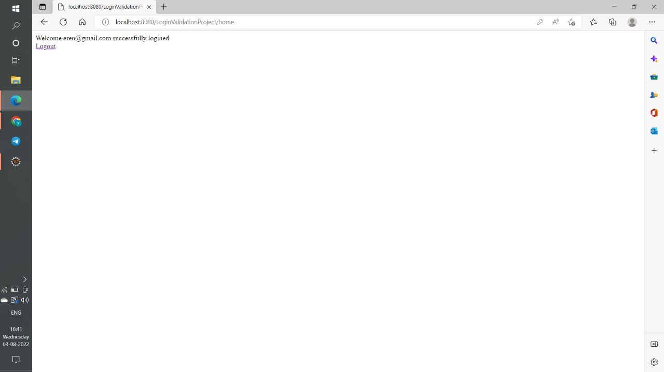

Slide 3
